Slide 1
The role of PKCα localisation in Prostate Cancer
Amanda Oliver
Supervisor: Michelle Hill
Co-supervisor: Rob Parton

Slide 2
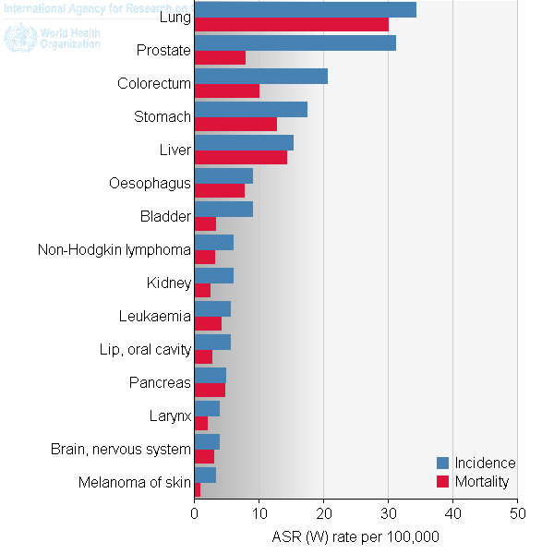
Prostate Cancer
15% of cancer incidences
6% of cancer deaths
Advanced, metastatic tumours are difficult to treat
Caveolae are implicated in prostate cancer progression
Ferlay J et al. (2012).

Slide 3
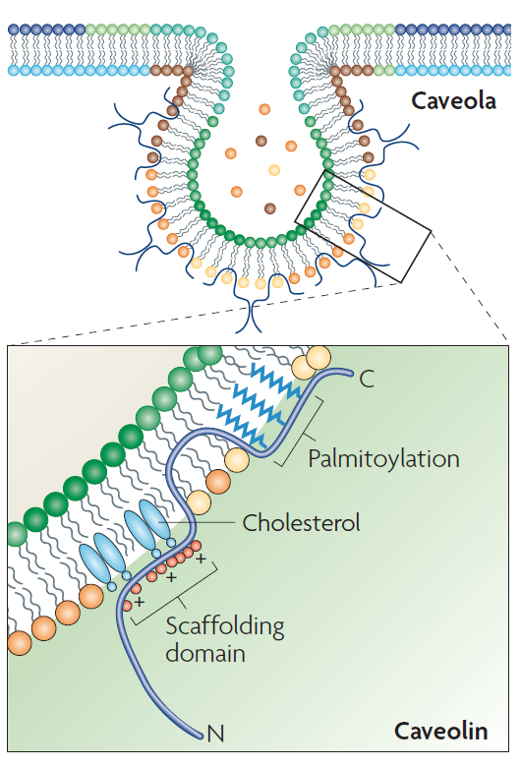
Caveolae
60-80nm membrane invaginations
Type of lipid raft
Multiple cellular functions including endocytosis, lipid regulation, calcium signalling and mechanosensing
Signalling molecules enriched in lipid rafts
Parton, R. G. & Simons, K. (2007).

Slide 4
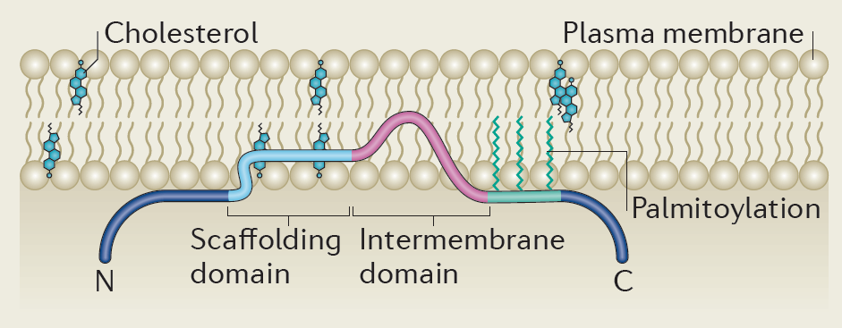
Caveolins
Integral membrane protein family
Structural components in caveolae formation
Three members: CAV1, CAV2 and CAV3
CAV1 essential in non-muscle cells
CAV1 associated with aggressive, late stage prostate cancer (Moon et al. 2013)
Parton, R. G. & del Pozo (2013).

Slide 5
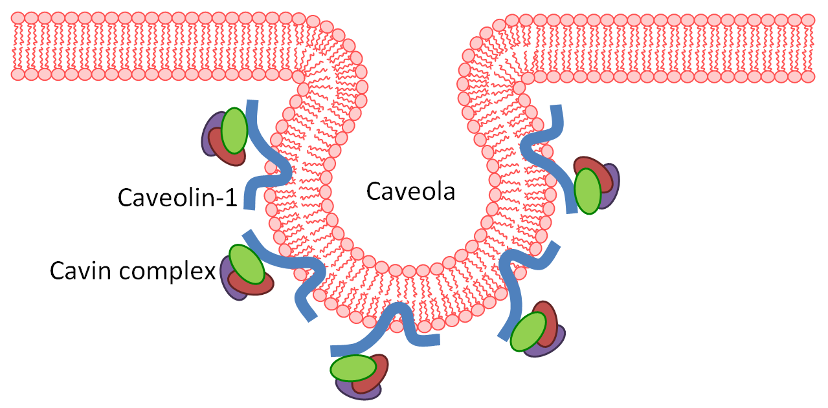
Cavins
Newly identified caveolae coat protein family
Four members: cavin-1, cavin-2, cavin-3, cavin-4
Form oligomeric complex and associate with caveolae
CAV1 and cavin-1 dependent process (Bastiani et al. 2009)
Cavin-1 is essential for caveolae formation (Hill et al. 2008)

Slide 6
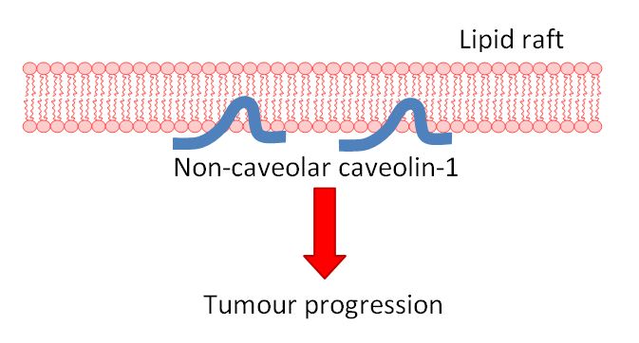
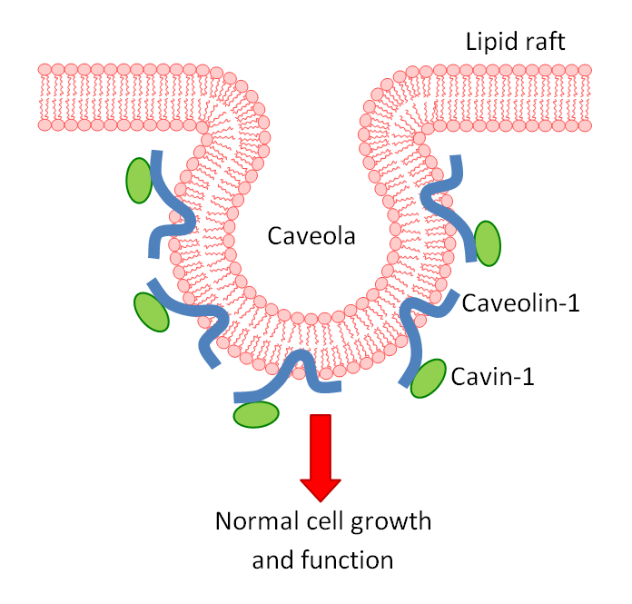
Cavin-1 attenuates the tumour promoting effects of CAV1
Without cavin-1, CAV1 lies on planar membrane
Non-caveolar caveolin-1 is tumour promoting in prostate cancer
Cavin-1 expression attenuates this tumour promoting effect (Moon et al. 2013)

Slide 7
Protein Kinase C
Family of serine/threonine kinases
Signalling specificity vital for function
Subcellular localisation important for signalling specificity
PKC
Cytoskeletal regulation
Gene expression
Growth
Differentiation
Cancer

Slide 8
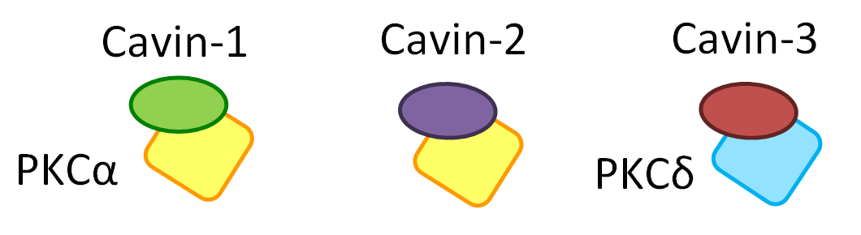
PKCα is localised in lipid rafts
PKCα has a known role in migration
Overexpression of PKCα is found in various cancers
PKCα is recruited to the lipid raft fraction by cavin-1 (Hill et al. 2012)
Both cavin-1 and cavin-2 bind to PKCα (Mineo et al. 1998)
Cavin-3 binds to PKCδ (Izumi et al. 1997)

Slide 9
Hypothesis
Cavin-1 expression decreases migration in prostate cancer
Cavins bind to PKCα
Binding of cavins recruits PKCα to caveolae in cavin-1 expressing cells, leading to reduced migration.
PKCα is recruited to lipid rafts by cavin-1
PKCα is known to regulate cell migration

Slide 10
Aims
Determine the relative abilities of cavin proteins to recruit PKCα to caveolae and investigate the mechanism behind this recruitment.
Correlate recruitment of PKCα to caveolae with a phenotypic change in migratory ability using functional assays.
Investigate the mechanisms by which the caveolar localisation of PKCα may influence other proteins to bring about a phenotypic change.

Slide 11
PC3 cells as a model
Androgen-independent, metastatic prostate cancer cell line
WT express caveolin-1 but no cavins
Cell lines with caveolae | Cell lines lacking caveolae
Cavin-1-GFP | GFP control
Cavin-1-GFP + Cavin-2-cherry | Cavin-2-GFP
Cavin-1-GFP + Cavin-3-cherry | Cavin-3-GFP

Slide 12
Methods – Aim 1
Aim 1: Which cavins can recruit PKCα to lipid rafts?
Co-localisation of PKCα and cavins by immunofluorescence
Direct binding of PKCα and cavins by co-purification
Co-fractionation of PKCα and cavins

Slide 13
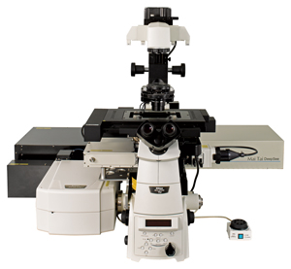
Co-localisation by immunofluorescence
Fixation, permeabilising and blocking
Incubate with PKCα primary antibody
Cells grown to 70% confluent on coverslips
Incubate with secondary antibody for PKCα
Incubate with secondary antibody for caveolin-1
Incubate with caveolin-1 primary antibody
View on confocal microscope
Stably transfected cavins tagged to GFP
Transiently transfected cavins (cavin-2 and cavin-3) are cherry-tagged

Slide 14
Co-fractionation
Targeting of PKCα and cavins in detergent resistant fractions
Cells grown to 70-80% confluent in dishes
Detergent resistant fraction (DRF)
Western immunoblotting to compare PKCα levels in the lipid rafts of in each cell line
Wash
Pellet
Collect cells and centrifuge
Detergent soluble fraction (DSF)
Cells homogenized in TNE with 1% Triton-X100
Supernatant
Lyse on ice and centrifuge again

Slide 15
GFP Nanotrap
GFP tagged cavin protein
Direct binding of PKCα and cavins using GFP nanotrap
Other proteins
Western immunoblotting to determine presence of PKCα
Cavin-GFP PC3 cell
Addition of GFP binding protein
Purification
Lyse cells
PKCα
GFP
Control PC3 cell

Slide 16
Method – Aim 2
Aim 2:Does PKCα recruitment to caveolae correlate with decreased migration?
Transwell migration assay
1 x 10⁶ cells in serum free media
Incubate cells for 24 hours at 37°c
Remove filter, wash and fix cells
Stain with DAPI and quantify
Polycarbonate filter with 8μm pores
Serum containing media

Slide 17
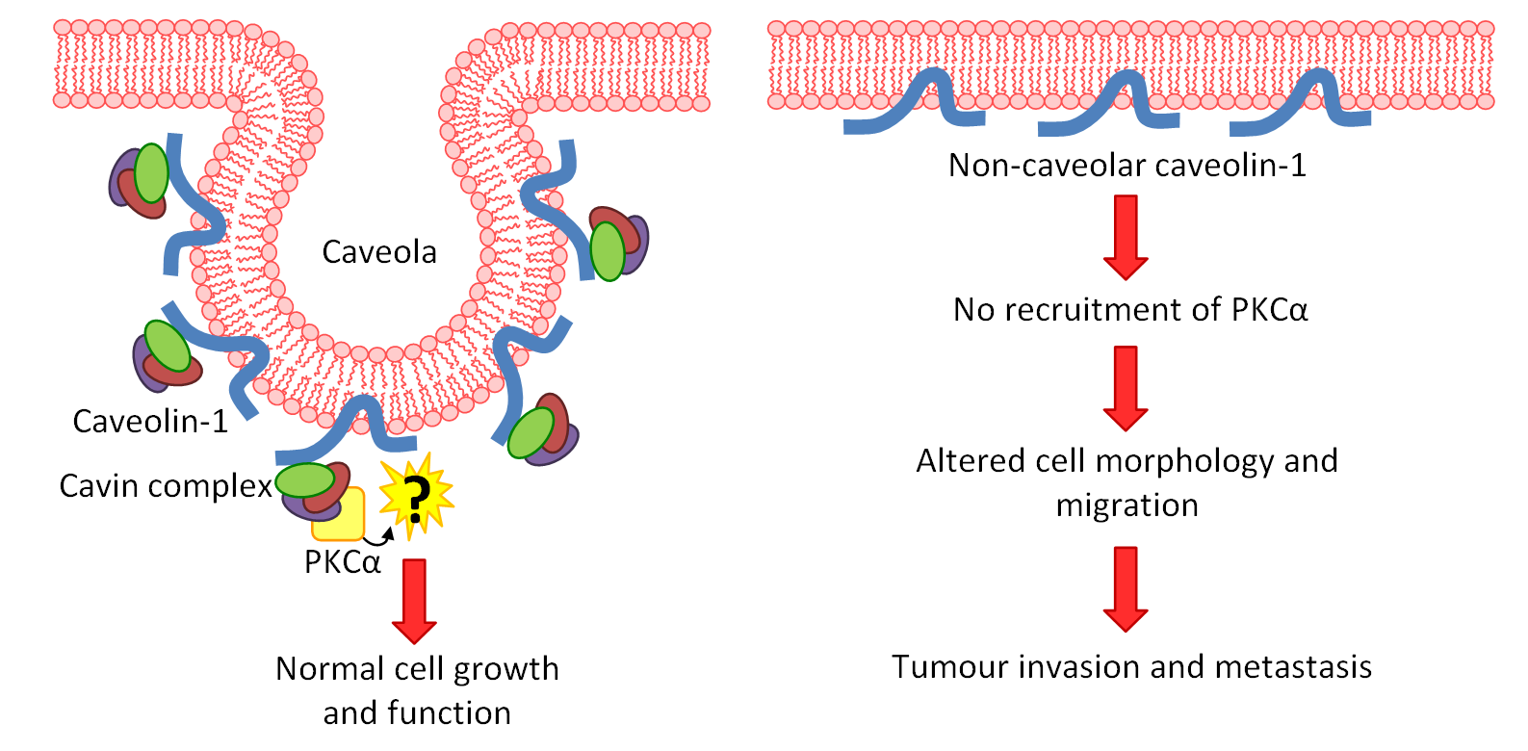
Expected results
Aim 3
Aim 1
Aim 2

Slide 18
Methods – Aim 3
Aim 3: How does PKCα recruitment to caveolae influence migration?
Previous proteomics study to identify PKCα substrates in lipid rafts of cavin-1 expressing PC3 cells
Investigate downstream effectors of PKCα in lipid rafts
Co-localisation of putative PKCα substrate moesin and caveolae

Slide 19
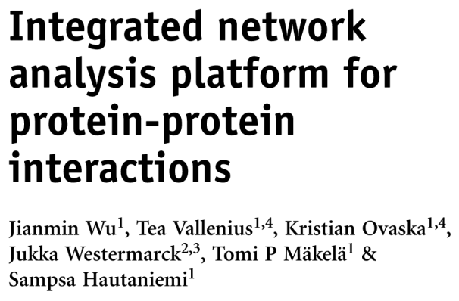
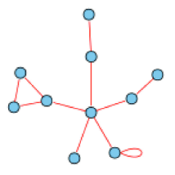
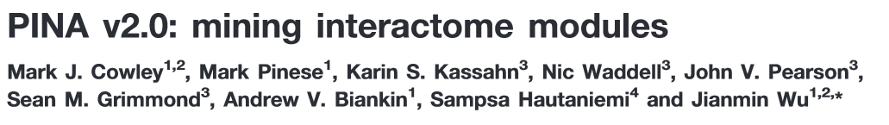
Bioinformatics analysis
Protein-protein interaction network analysis (PINA) - cbg.garvan.unsw.edu.au/pina/
Use PINA to generate PPI networks
Look for downstream effectors of identified PKCα substrates that have a role in cell migration

Slide 20

Phospho-moesin localisation
Cavin-1-GFP PC3 cells
GFP PC3 cells
phospho-ERM antibody
Immunofluorescence
anti-moesin antibody
anti-CAV1 antibody
Cholesterol staining with filipin III
View on confocal microscope
Cavin-1 can be viewed by its GFP tag

Slide 21
Significance
Advanced prostate cancer is difficult to treat
This project will hopefully uncover potential pathways for advanced prostate cancer therapies
Development of such therapies could contribute to reducing prostate cancer deaths
Ferlay J et al. (2012).

Slide 22



Acknowledgements
Supervisor: Dr Michelle Hill
Co-supervisor: Professor Rob Parton
Hill Lab
Alok Shah, Anup Shah, Bastien Morlet, Dr Cassandra Davitt, Emran, Jayde Ruelcke, Dr Shashank Pandey, Dr Sunny Moon

